Slide 1

2020 COVID-19 Containment measures effectiveness' study
United States versus Global outcomes
Notes:
The datasets I used for my analysis are from Kaggle and consist of the World Health Organization’s Covid-19 ‘confirmation of infection’ time series for both the Global and US datasets.
My hypothesis is that this data will show that Globally, the containment measures were more effective than they were in the US.

Slide 2

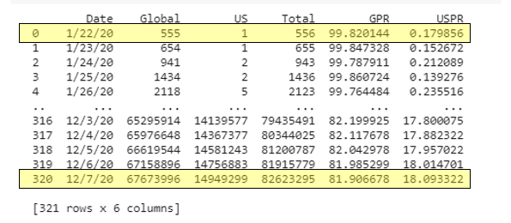
Dates Covered
Percentage Rates
First and last 5 rows of data
Notes:
The data that I will examine, is the ‘Daily Percent of Total’ for Global and US infection rates, covering the reporting period of January 22, through December 7, 2020.
To do this, I cleaned each data set and removed non relevant data, reshaped, and merged the data into a format where I could then perform some calculations to find the percent of total for each day’s global and us reported case confirmations.
This data shows that Globally, the percent of total at the beginning of the year was 99.8 % which fell to 81.9 % by the end of December, a drop of 17.9%. Inversely, the US percent of total started at .17 %, going up to 18%, an increase of 17.83% in the same period.
Working from this observation, I believe the hypothesis to be true. However, further visualizations of the data are required to either prove or disprove the validity of my hypothesis.

Slide 3
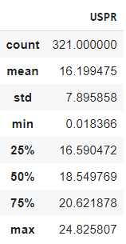
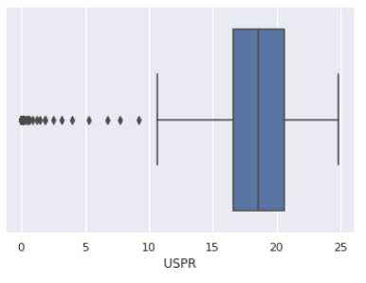
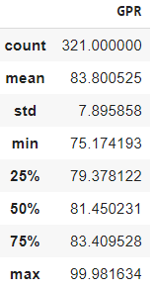
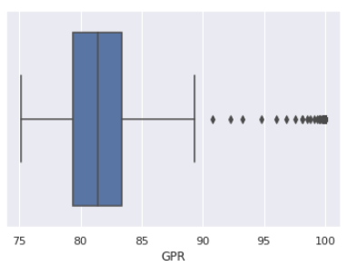
Distribution of
Covid-19
confirmed cases
Notes:
I first decided to look at the distribution of cases with a breakdown of the five points of measurement. The count of data points is the same, and they both have the same standard deviation. Where we see the differences is, in the min, max, mean and quartile statistics.
This is also reflected in the box charts, which provide a visual interpretation of the information. These charts also show where the outliers for the data set reside, for the US, they are on the lower end and for Global they are on the higher end.
This information is important to know but does not provide enough evidence to prove or disprove my hypothesis, so we move on to a different type of visualization.

Slide 4
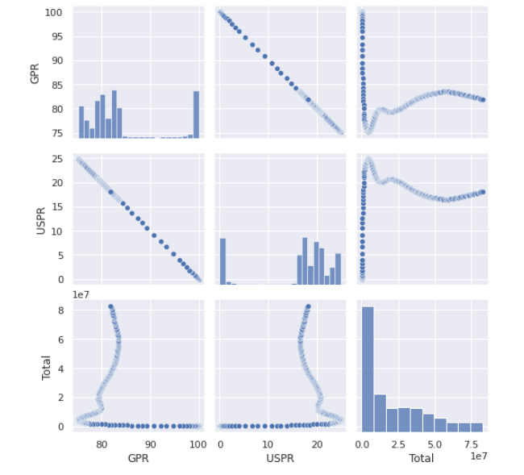
Paired plots for overview of data
Notes:
By using a pair plot we get a rapid visualization of the data, both in the distribution of single variables and relationships between the two variables.
I initially noted that these charts show the confirmation rates of the global percentage rate against the us percentage rates, in a ‘mirrored image’ of the data points, as was indicated in the preliminary data review.
The scatterplots shown in row one, box two and row two, box one also reflect a negative linear correlation as it is almost a straight line at a 45-degree angled to the left. Also observable from these plots are the increasing/decreasing density levels as indicated by the hue density of the plotted data point.
When inspecting the Total bar chart at the bottom on the right, we see that it illustrates that whereas the total number of cases was initially high, there is a progressive decline of reported cases over time, as to be expected when considering containment measures being implemented.
The GPR as compared against the USPR looks interesting, and I will be taking a closer look at these with the next slide.

Slide 5
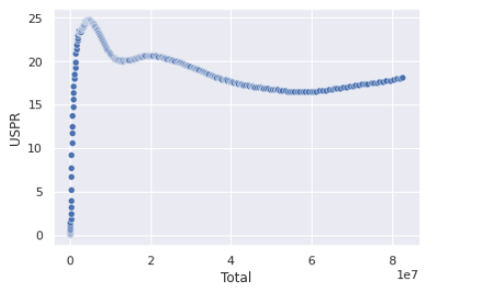

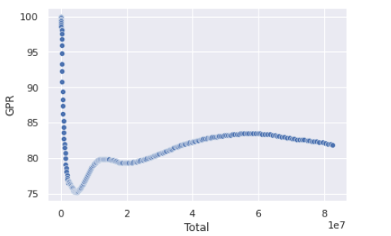
US and Global
percentage of total cases
measured against time
Notes:
For a deeper look at the scatterplots, I began by visualizing each group by comparing to the total number of cases
First, we look at the USPR (United States Percentage Rate) which begins with a low correlation between the Total number of cases and those reported. Observing the increase over time, in a positive correlation shows the increase in observations in relation to the total. This indicates the US containment initiative to be ineffective.
Moving on to the GPR (Global Percentage Rate), we observe an initially high correlation between the Total number of reported cases and those reported Globally as reflected in the GPR. Noting the reduction over time, shows the decrease in observations in relation to the total. This indicates the Global containment initiative to be effective.
By comparing the 'mirrored image' plots shown in these two scatterplots, a proof of the hypothesis can be observed.

Slide 6
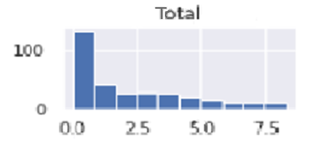
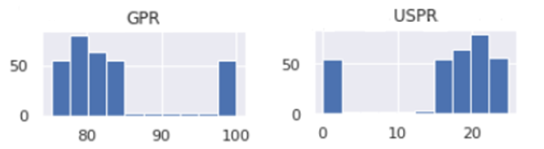
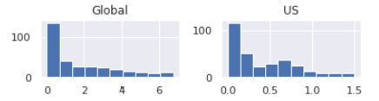
Comparison of confirmations over time
Notes:
Continuing to explore the data, we examine it using an expanded series of bar charts.
By looking at the charts which contain the daily counts for both Global and the US, we can observe the increases and decreases over the time frame, including the secondary spike in the US data. This is another proof of the hypothesis.

Slide 7
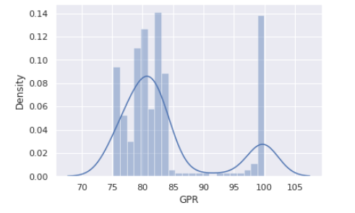
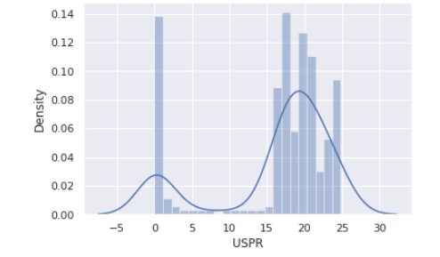
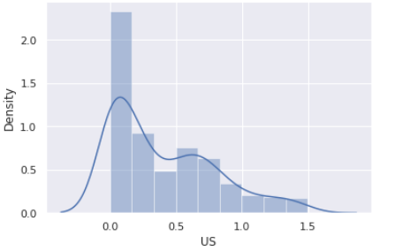
Looking at the data using density plots
Notes:
I then looked at the data using density plots to display where each series of values are concentrated over the interval, to better visualize the previous bar charts data.
The top row of charts plots the density for the percentage of total cases, displaying the data as it was in the pair plot, and presenting no new insights.
However, if you look at the bottom row of charts, they reflect the density of the actual reported cases by each group. Allowing us to see the secondary spike of confirmations halfway through the timeframe for the US, again proving the hypothesis.
With three visualization providing proof of hypothesis, it is time to validate our findings by conducting a pearson r statistical test.

Slide 8
Pearson r tests to measure the statistical relationship
The closer the number is to 1, the stronger the correlation
['GPR'],['USPR’]
(-0.9999999999999999, 0.0)
['Global’],['US’]
(0.9956845956729282, 0.0)
Probability of Randomness
Notes:
As we observe in the pearson r results above, the correlation coefficient for both the case counts and the percentage of totals of the US and Global data are -0.999 and 0.995 respectively, this shows an extraordinarily strong correlation.
If we move on to the second number, the probability factor that this is indeed a random occurrence finding is, in fact 0.00 for both, indicating that the correlation being random, is an impossibility.
This provides the mathematical validation for the observed visualized proof of the hypothesis. Which shows that the US failed in having effective containment measures, or in implementing such measures over time, as the pandemic continued to progress.
I believe that this data is valuable, providing proof that the approach the US has/had is inefficient, and that a deep analysis of the global data is needed to see what areas had the most effective containment rates, and identify the steps they took to achieve those rates. That analysis should help the US create a ‘best practice initiatives’ to be applied by national mandate.

